Slide 1
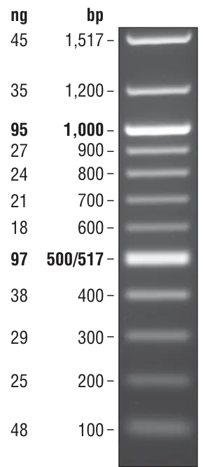

Rx vLRR 52-66 PCR AMP Products; 24.06.2026
52
53
54
55
56
57
58
59
60
61
62
63
64
65
66
bp
1,517
1,200
1,000
900
800
700
600
500
400
300
vLRR | 52 | 53 | 54 | 55 | 56 | 57 | 58 | 59 | 60 | 61 | 62 | 63 | 64 | 65 | 66
Length (bp) | 595 | 499 | 433 | 706 | 436 | 556 | 613 | 631 | 733 | 1055 | 886 | 784 | 940 | 343 | 894
Confirmation
Notes:
PCR size verification of Rx vLRR inserts. Agarose gel electrophoresis of PCR-amplified vLRR inserts from Rx–vLRR candidates 52–76 and 187–191. Candidates 52–66 and 67–76/187–191 are shown in separate panels, with the expected amplicon size indicated for each construct. All displayed PCR products were consistent with their expected sizes and were recorded as successfully verified.

Slide 2
Rx vLRR 67-76 187-191 PCR AMP Products; 24.06.2026
bp
67
68
69
70
71
72
73
74
75
76
187
188
189
190
191
1,517
1,200
1,000
900
800
700
600
500
400
300
vLRR | 67 | 68 | 69 | 70 | 71 | 72 | 73 | 74 | 75 | 76 | 187 | 188 | 189 | 190 | 191
Length (bp) | 640 | 703 | 343 | 457 | 505 | 358 | 415 | 853 | 373 | 433 | 730 | 650 | 526 | 964 | 1009
Confirmation

